Slide 1
Training Project Management

Slide 2
Welcome to T-Engineering!

Slide 3
Agenda 2015 08 21
09:00 Presentation – General Information (T-Eng)
Presenter: CEO Klas Lundgren
09:30 Project Management
Presenter: QA Anna Mörkerdal
10:30 Project Management Roadmap
& Master Timing Chart
Presenter: PMO Dennis Kristensson
11:30 Project Management Logbook
Presenter: PMO Dennis Kristensson
12:00 Lunch
13:00
Presenter: CEO Klas Lundgren
14:00 End

Slide 4
Project Management

Slide 5
Project Management Process → CMMI
Our Project Management Process is based on CMMI
CMMI is a process improvement training and appraisal program specialized in software development.
CMMI focuses on improving processes to achieve raised quality and effectiveness.

Slide 6
Project Management → Process Areas
Requirement Management
Project Planning
Configuration Management
Project Monitoring & Control
Measurement & Analysis
Project & Product Quality Assurance
Identify Relevant Stakeholders
Analysing & Understanding Requirements
Risk Assessment
Establish estimates (resources, cost, time, quality)
Develop Project Plan (Logbook, MTC)
Define Project Process
Establish Baseline
Establish Configuration Management System
Change Management
Monitor project against Project plan - Risks, Data, Progress, deviations (MTC, cost, quality)
Manage Corrective Actions
Establish Measurement & Analysis Activities
Collect & Analys Data
Objectively Evaluate Process & Products
Monitor & controll the process
Objectively controll adherence to process

Slide 7
Pre-Requirement Review Meeting
Requirement Checklist
Change/Addition suggestions
Pre-Requirement Review Meeting
Review existing Requirement documents
Assess quality of extisting Requirements
Identify
missing Requirements
Identify
missing Stakeholders
Identified Stakeholders and their Requirements
Team commitment to requirements
Requirements Risk Assessment
Update
Update

Slide 8
Requirement Review Meeting
Change suggestion
Requirement Review Meeting
Walk-through Requirements
State Risk Assessment Issues
Commitment Assurance
Agreed upon Requirements
Team commitment to requirements
Requirements Risk Assessment
Create Actionplan for risks
Actionplan Template

Slide 9
Project Risk Assessment
Project Risk Assessment is initially done after collecting all Stakeholders requirements
Purpose is to judge feasibility of the project and to be able to work preventative with risks
The more risks we are aware of in the beginning, the more prepared we are if they should occur

Slide 10
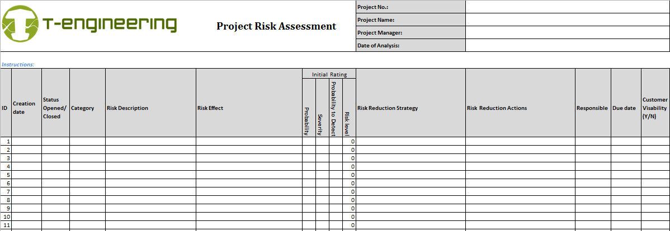
Project Risk Assessment
Risk Description: What risks do we see within the project?
Risk Effect: What will happen if risk occur? How will it affect the project → time, cost, quality
Rating: Probability, Severity, Probability to detect, gives you a Risk Level.
Risk Reduction Strategy: What can we do to minimize high level risks?
Risk Reduction Actions: What have been done to reduce high level risks?

Slide 11
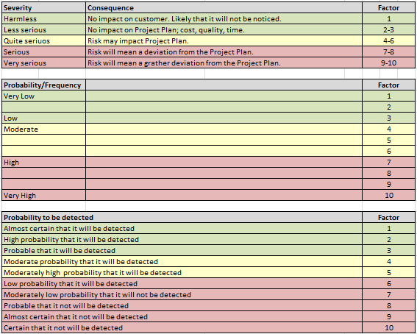

Slide 12
Project Gate Reviews
Requirement Review
Agreement Review
Confirmation Review
Validation Review
Production Review
Closure Review
Define
Plan
Execute
Close
Gate Review are used to control that the project runs according to Project Process
All mandatory exit criterias must be fulfilled at every gate.
The QA person will attend all Gate Reviews to objectively observe adherence.
The Project Manager are responsible to ensure the gate material will be presented and completed in each gate.
Risks and Quality issues will be raised, monitored and communicated to Stakeholders
In the meeting the following areas shall attend → PMO, Project Leader, QA, Responsible Engineers, Team members.

Slide 13
Project Management Roadmap

Slide 14
Introduction Project Management Roadmap
Purpose: Provide an overview of the importance of clear targets and requirements for the development. It is applicable for all components not only controls.
Pre Development/Advanced engineering is one phase ahead of this were the development target is to proven the technology. You will gain time if Pre development project are done prior this road map.
The road map is not taking timing into consideration due to the facts that this is dependent on project scope and will always be different.
It shows T-Engineering ´s experience from other development projects.

Slide 15
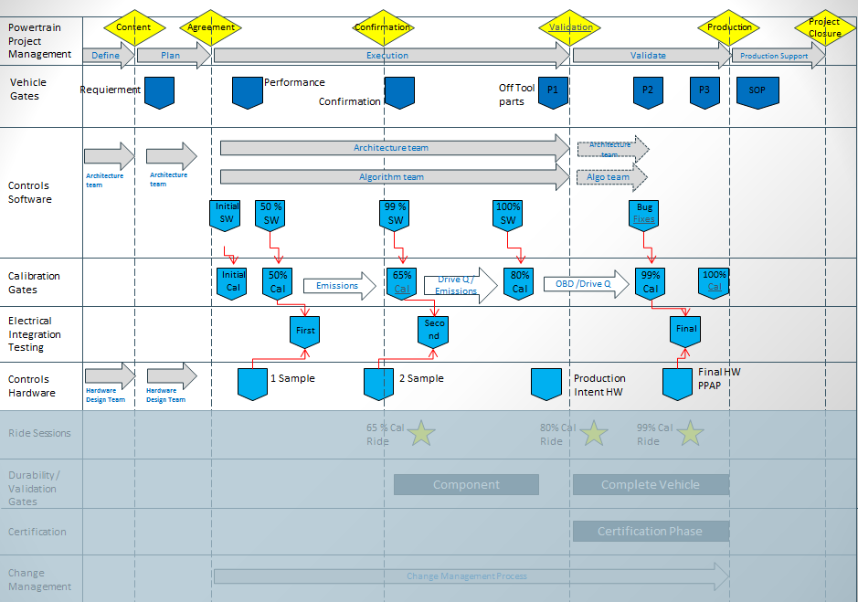
Project Management Roadmap (Home Development ECU)

Slide 16
Master Timing Chart
(MTC)

Slide 17
Introduction to Master Timing Chart (MTC)
Purpose: Each project shall have a Master Timing chart on a high level to show the overall timing for the project. This will be the guide for the Engineering departments to plan there work.
Why is this helpful
Will give management a good view of the project timing.
Easy and visual for the project team.
This plan shall always be easily available for the project members. (Project Home page, Visualization wall….)
This document is a living document during the project execution to handle change management etc.
Use this to ensure that our customer agrees on the overall timing and deliveries.

Slide 18
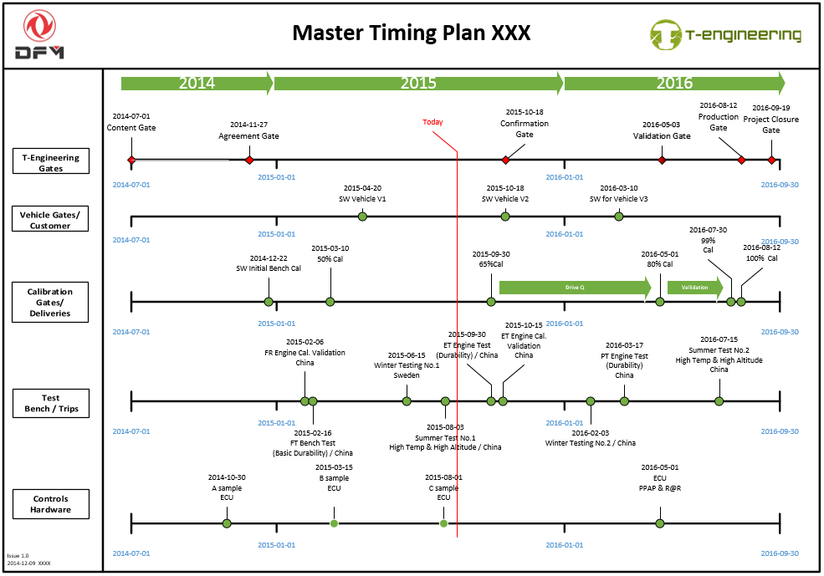
Master Timing Chart (MTC)

Slide 19
Project Management Logbook

Slide 20
Introduction to Project ”Logbook”
Purpose: To support the project leader with the financial/cost and resource/manpower calculations for the project scope. After project start the project leader will follow finance and resources according to project scope (Budget v/s real cost)
Why use the logbook
To be able to ensure the project is running according to the financial budget on a monthly base.
With this information the company can act in time if something is not on track.
Tracking of resource used in the project. Resources / Manpower
Important is to learn from every project to improve the calculations for new quotations. In the logbook we will learn if we used the correct assumptions during the calculations phase and execution.

